Slide 1
Welcome to Ms. O’Donnell’s Kindergarten Open House
2014-2015
Alston Ridge Elementary

Slide 2
Welcome!
Thank you for coming! ☺
Volunteering: Beginning in Q2, there will be a signupgenius for classroom volunteers.

Slide 3
SUPPLIES
Supplies:
K Supplies on Website
In addition to the K supply list:
Blue and yellow folders
Pencil box

Slide 4
Absences
For an absence to be excused, you must send a hand-written note to school. For safety reasons, emails are not considered excuses because they do not have signatures.

Slide 5
A DaY IN THE LIFE OF A KINDERGARTENER

Slide 6
Daily schedule
8:45-9:15: Arrival & Morning Work 9:15-9:30: Journal Writing 9:30-9:45: Morning Meeting 9:45-11:15: Literacy 11:20-11:50: Lunch 11:50-12:00: Bathroom Break & Rest 12:00-12:30: Social Studies 12:30-1:00: Writing 1:00-1:45: Specials 1:45-2:00: Bathroom Break & Independent Work 2:00-2:30: Recess 2:30-2:45: Snack 2:45-3:30: Math 3:30-3:45: Read Aloud & Dismissal

Slide 7
Arrival & morning work
Morning Routine:
Hang up bookbag
Check green folder
Put notes in the red bin
Wash hands
Start morning work
Read to self

Slide 8
Journal time
After morning work, students write and draw in their journals. This shows a progression of their literacy development and it helps children understand that they are authors and illustrators!

Slide 9
MORNING MEETING
Instills a “community of learners”
Review days of the week, months of the year, weather, days we have been in school
Pledge of Allegiance
We sing and prepare for the day. ☺

Slide 10
LITERACY
Introduce theme/skill of the week
Literacy Centers: set up for independent or guided practice of reading and writing skills
Guided Reading: The teacher pulls small groups of students for differentiated reading support.

Slide 11
SHARED READING
Students join in and share the reading with the teacher. Students observe an “expert” reading the text with fluency and expression. The text is large enough for students to see clearly. We practice reading by “choral reading” and making sure we sound good when we read.

Slide 12
PHONEMIC AWARENESS
Phonemic Awareness: ability to hear, identify, and manipulate sounds in spoken words
Examples of Phonemic Awareness Skills
Blending: What word am I trying to say?
/n/ /o/ /t/
Segmentation (first sound isolation): What is the first sound in not?
Segmentation (complete): What are all the sounds you hear in not?
Deletion: Take off the /t/ in table, what word do you have?

Slide 13
WORD WORK: PHONICS
Phonics: awareness of letter/sound relationships
New Phonics Program: Letterland
Word Wall
Examples of tasks:
Letter recognition, connecting letters with sounds, sight words, reading and writing consonant-vowel-consonant words (CVC)

Slide 14
INTERACTIVE WRITING
Teacher and students “share the pen” to collaboratively compose a written message.
The children contribute the letter sounds that they hear and the teacher supports the students by writing the letters or assisting students as they write.
Through interactive writing, students understand the concepts of print. They see that you start on the left, leave spaces between words, and use letter/sound relationships to sound out words. Most importantly, they see that what you say can be written down and what you write down can be read.

Slide 15
HANDWRITING
Learning to write can be stressful for some children and we like to make it fun in kindergarten! We practice each letter by using the “verbal path” you see at your child’s seat.
We practice with individual whiteboards, tracing in sand, and other hands-on materials.

Slide 16
LUNCH! ☺
The students walk to the dining hall and sit at our table. Packers go straight to our assigned table, and buyers are assisted by our TA.
Buyers have a clothespin with their student ID number on it and they use this at the register after they get their lunch.
If you are meeting your child for lunch, you can meet us in the cafeteria at 11:20. Goodbye hugs are usually given in the hallway after lunch and before their bathroom breaks.

Slide 17
REST & READ
Students listen to calm music and can choose to rest their head, read a book to themselves, or finish work that is not yet complete.

Slide 18
WRITING WORKSHOP
We start with a mini-lesson on a specific skill, followed by independent writing time where students can practice what they learned.
Students write by sounding out words and using the materials in our classroom (word wall, name tag, labels, etc.)
Sharing time

Slide 19
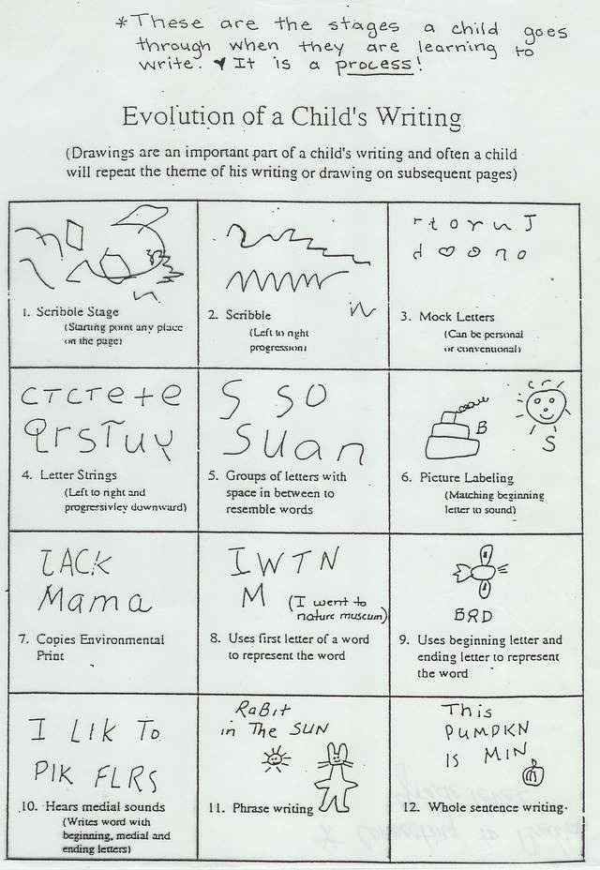
Evolution of a child’s writing

Slide 20
SCIENCE/SOCIAL STUDIES
Social Studies
Being a good citizen
How we are alike/different
Cultures around the world
Needs and wants
Geography
Science
Properties
Five Senses
Weather
Animals

Slide 21
SPECIALS
Guidance
P.E.
Technology
Music
Art
Media Center

Slide 22
Recess (outdoor p.e.)
Students go outside for 30 minutes ☺
Outdoor play refines a child’s gross motor and social skills.
Children love outdoor play because they can use their imaginations!

Slide 23
MATH
Math “warm up”
Math story or skill lesson
Math centers: children explore, investigate, estimate, make predictions, count, build, and talk about their ideas
Guided Math: The teacher works with small groups of children to best meet student needs

Slide 24
MATH
Math time is spent working on several skill areas such as:
Counting & Cardinality (developing number sense 1-100, reading and writing numerals, comparing and ordering numbers)
Operations & Algebraic Thinking (addition, subtraction, decomposing numbers)
Number & Operations (working with numbers 11-20)
Measurement & Data (describing measurable attributes using appropriate vocabulary, classifying objects into categories)
Geometry (2D and 3D shapes, positional words)

Slide 25
dismissal
At ARE, we have a quiet dismissal on the TV.
Students traveling home via carpool and vans are given colored tags. They watch the TV and listen for the honk sound and watch for their bus.
If you are changing your child’s mode of transportation, you MUST SEND IN A HAND WRITTEN NOTE or CALL THE SCHOOL.

Slide 26
BEHAVIOR MANAGEMENT
The Golden Rule
5 “Life Skills” - Respectful, Helpful, Careful, Responsible, and Patient
Rules Dance
Follow directions quickly
Keep your hands and your feet to yourself
Use kind words
Be a good friend
Raise your hand to speak
Be a 5 star listener
And ALWAYS DO YOUR BEST! ☺

Slide 27
homework
Monthly homework calendars are optional, but highly recommended ☺
Blue folders are turned in each Friday
Read 20 minutes each night
Wake County’s math homework will be put on the “return to school” side. Please return to school the next day.

Slide 28
grading
1st/3rd Quarter Parent Conferences
Report cards every quarter
Progress reports will be sent home mid-quarter for students not meeting benchmarks

Slide 29
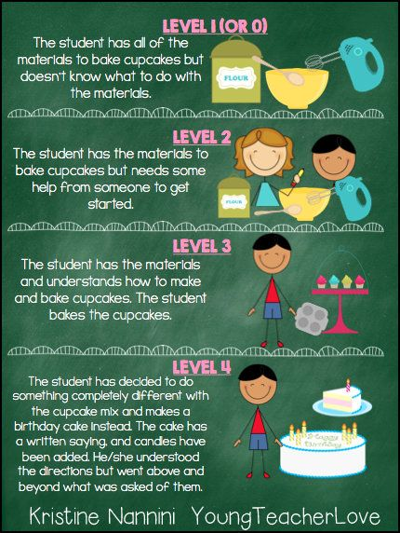
Standards based grading

Slide 30
FIELD TRIPS
Typically 4/year
Tentatively scheduled for 2014-2015: Pumpkin Patch, Musical Performance, Science Fun for Everyone, and a museum.

Slide 31
SPIRIT DAYS
On Fridays, students wear Alston Ridge shirts or green and blue. Teachers count the number of children wearing green and blue… the highest number wins the SPIRIT STICK for the following week!

Slide 32
birthdays
ARE School Policy: No food for birthday celebrations
We invite you to read a book aloud to the students on their birthday (usually at 11:00).
ARE parents usually donate a book to the classroom library in honor of the child.

Slide 33
Reading levels
KIA (Kindergarten Initial Assessment) reading levels are in a sealed envelope in your child’s cubby.
Please take before you leave tonight. ☺
Description of levels:
<PC: Student has not yet mastered print concepts
PC: Print Concepts
RB: Reading Behaviors
A-Z: Student reading levels
Students should end Kindergarten on at least a level D.

Slide 34
Thank you for coming!
Please contact me with any questions or concerns.
Email:
codonnell@wcpss.net
Class website:
msodonnellARE.weebly.com

